Slide 1

CN101.3 - Data Communication and Network
Department of Network and Security
Layered Architecture
Isuru Sri Bandara
isuru.s@nsbm.ac.lk

Slide 2

What is Layered Architecture

Slide 3

Why do we require Layered Architecture?
Reduce the complexity of the design (Divide and conquer approach) – this approach makes a design process in such a way that the unmanageable task are divided into small manageable tasks.
Provides the independence of the layers, which is easier to understand and implement
Easy to modify without affecting other layers.
Easy to test where each layer of the layered architecture can be analyzed and tested individually.

Slide 4

Layered Architectures
There are two layered architectures
OSI 7 Layer architecture
TCP/IP protocol architecture

Slide 5
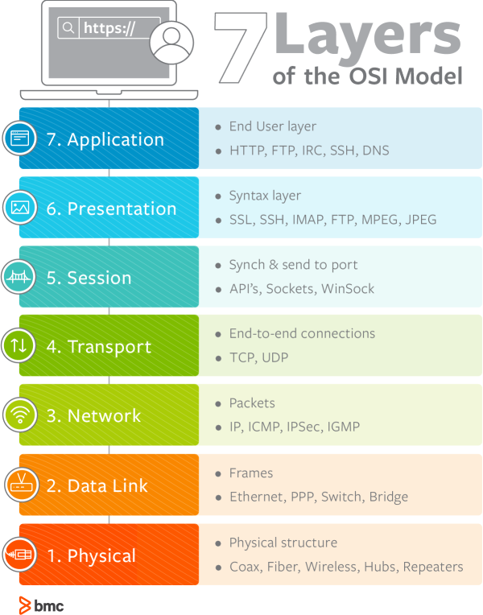
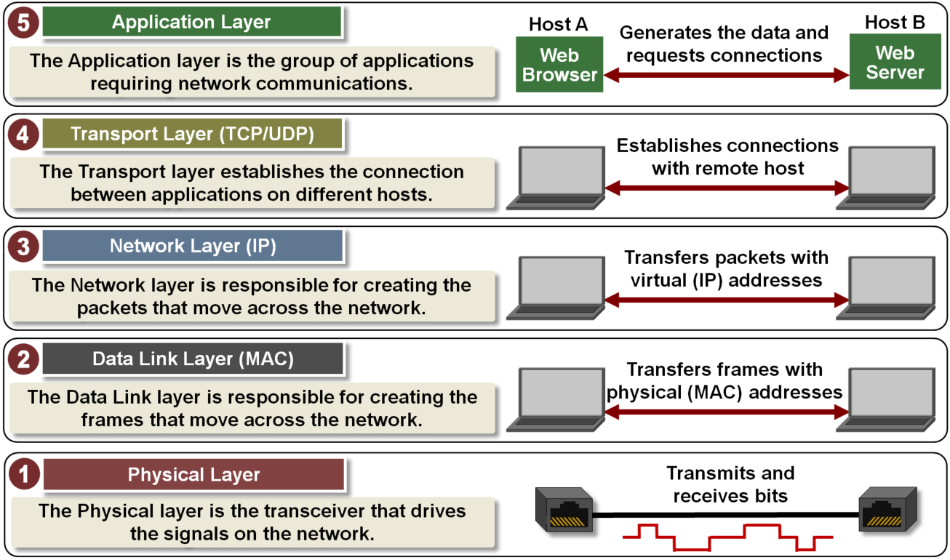
Layered Architectures
TCP/IP Model
OSI Model

Slide 6

The OSI Model
Stands for “Open Systems Interconnection”
OSI model is a tool used by IT professionals to actually model or trace the actual flow of how data transfers in networks.
So, basically, the OSI model is a logical model/representation of how the network systems are supposed to send data (or, communicate) to each other.

Slide 7
Why OSI Model ?
OSI (Open Systems Interconnection) is a reference model for how applications communicate over a network.
A reference model is a conceptual framework for understanding relationships.
OSI model was introduced by International Organization for Standardization (ISO) in 1984

Slide 8
Overview of OSI Model
The OSI Model is composed of seven layers with the application layer, which is closest to the end user, at the top, going all the way down to physical layer, in which the actual data transfer happens with the use of a transmission medium.

Slide 9
Overview of OSI Model

Slide 10
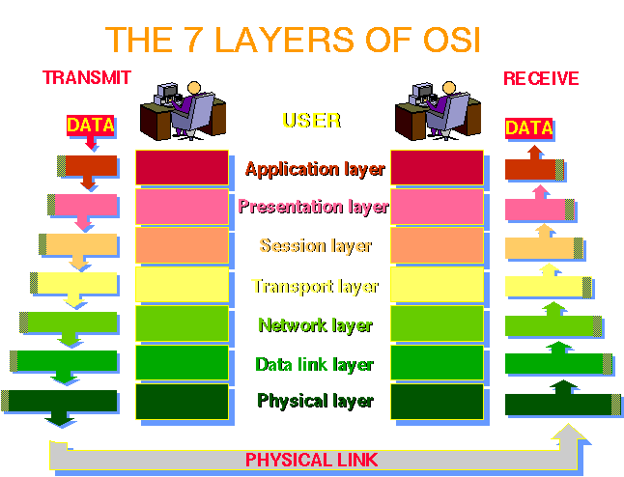
How it’s work

Slide 11
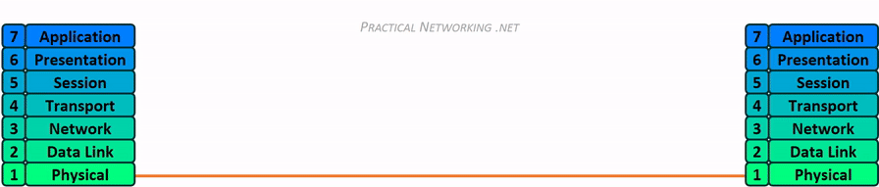
How it’s work

Slide 12
01. Physical Layer
This is the layer on which the real transmission of data bits takes place through a medium.
This layer is, as the name suggests, all the physical stuff that connects the computers together.
Responsible for electrical signals, light signal, radio signals etc.
Hardware layer of the OSI layer
Devices like repeater, hub, cables, Ethernet work on this layer
Protocols like RS232, ATM, FDDI work on this layer

Slide 13
02. Data Link Layer
This layer is responsible for organizing bits into frames and ensuring hop to hop delivery. Also assign the mac address of sender and receiver.
This is the layer on which the Switches operate on. Since routers operate at the network level, hence we can say that the MAC address resides at the data link layer.
All the computers in a specific network get plugged into a switch so that they can communicate with each other.
Responsible for encoding and decoding of the electrical signals into bits.
Manages data errors from the physical layer
Convers electrical signals into frames
Devices like Switch work at this layer

Slide 14
03. Network Layer
The main job of this layer is to move packets from source to destination and provide inter-networking.
This is the layer that the routers operate on. Since routers operate at the network level, hence we can say that the IP address is at the network level.
Logical addressing (IP Addressing) happens inside the Network layer.
Logical Addressing
Routing
Path determination
Different network protocols like TCP/ IP, IPX, AppleTalk work at this layer

Slide 15
04. Transport Layer
This layer has a very important job. It segment data and It decides how much information should be sent at a time. Segment contains Port No, Sequence no and data
So, when you are communicating with a website, this layer will decide how much data you can transfer and receive at a given point of time.
Also, this layer provides reliable process to process message delivery and error recovery.
Responsible for the transparent transfer of data between end systems
Responsible for end-to-end error recovery and flow control
Responsible for complete data transfer.
Protocols like TCP, UDP work here
UDP – Video Games, Movies, Online Streaming ( UDP faster than TCP )
TCP – WWW, Email, File transfer

Slide 16
05. Session Layer
This layer has the job of maintaining proper communication by establishing, managing and terminating sessions between two computers. For example, whenever we visit any website, our computer has to create a session with the web server of that website.
Responsible for establishment, management and termination of connections between applications.
The session layer sets up, coordinates, and terminates conversations, exchanges, and dialogues between the applications at each end.
It deals with session and connection coordination.
Works with APIs and NETBIOS

Slide 17
06. Presentation Layer
This is the layer in which the operating system operates with the data. Main functions of this layers includes translation, encryption and compression of data. Basically User interacts with Application layer, which sends the data down to Presentation layer.
Responsible for data representation on your screen
Encryption and decryption of the data
Responsible for Translation, Compression and Encryption data.

Slide 18
07. Application Layer
This is the topmost layer in the seven OSI Layers. This is the layer that the end-user (can be a computer programmer, or a regular PC user) is actually interacting with. This layer allows access to network resources.
Application layer supports application, apps, and end-user processes.
This layer is responsible for application services for file transfers, e-mail, and other network software services
Protocols like Telnet, FTP, HTTP work on this layer.

Slide 19
TCP/IP Model
TCP/IP Model helps you to determine how a specific computer should be connected to the internet and how data should be transmitted between them.
The purpose of TCP/IP model is to allow communication over large distances.
TCP/IP stands for Transmission Control Protocol/ Internet Protocol. TCP/IP Protocol Stack is specifically designed as a model to offer highly reliable and end-to-end byte stream over an unreliable internetwork.

Slide 20
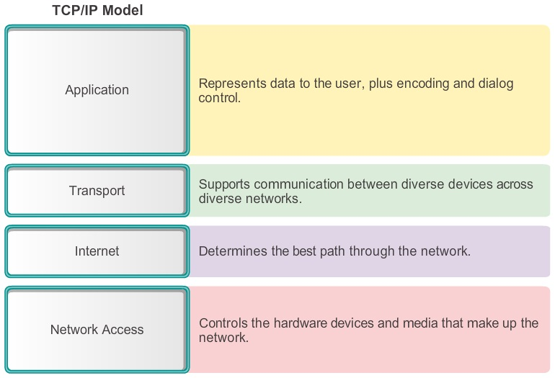
TCP/IP Model-Original

Slide 21
TCP/IP Model-New version

Slide 22
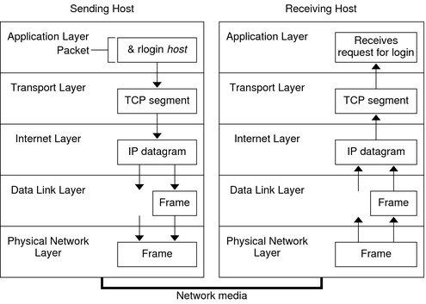
TCP/IP Model
Notes:
https://www.youtube.com/watch?v=aaJ1KcCDz-c&ab_channel=NexGenT

Slide 23
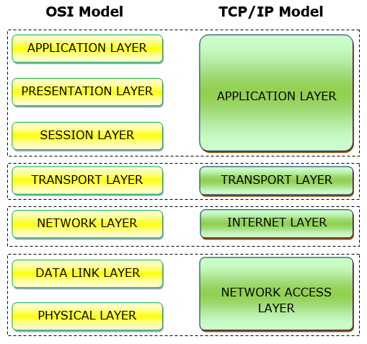
OSI VS TCP/IP

Slide 24
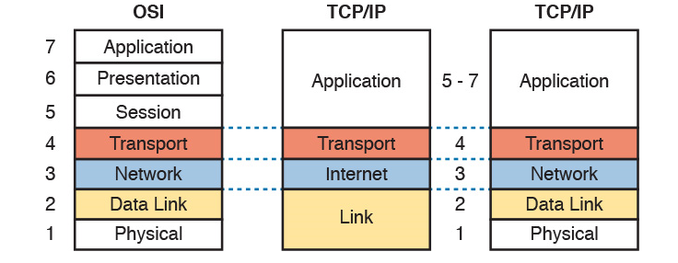
Overall Architecture- Overview

Slide 25
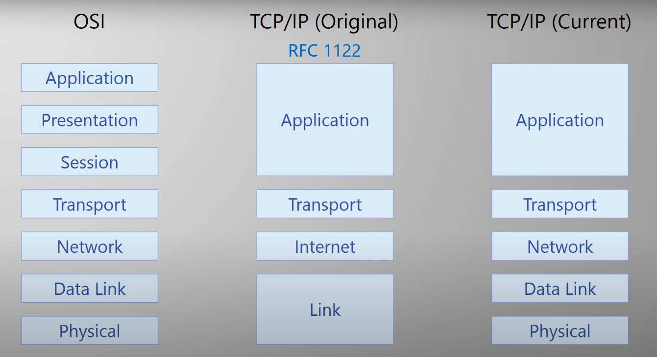
Overall Architecture- Overview

Slide 26

Thank You

